Slide 1

Data programming
FINAL PROJECT

Slide 2




Project Team
Harjaap Singh
Developer
Christian Frago
Developer
Mishthi Bhatiya
Analyst
Johns Jo Prince
Project Manager

Slide 3
Data Acquisition and Storage
In this project, we have demonstrated the acquisition of a data source from a remote source (URL) using Python programming language.
The data set we have chosen is relevant and meaningful to demonstrate the understanding of the type of data XYZ Corporation would be interested in.
We have stored the acquired data in a cloud database that we feel is most appropriate - MongoDB, a popular NoSQL database.
Our solution includes a pseudo-batch process that runs every 24 hours to acquire new data and store it in the MongoDB database.
This approach ensures that the data is up-to-date and available for analysis when needed.

Slide 4
Data Visualization and Fit Gap Analysis
Our solution includes a web application framework - Flask, that enables server-side coding using Python.
To display the data, we have used JavaScript on the client side, which enables the creation of visually appealing and interactive charts and graphs using Google Charts.
The visualization provides an interactive experience that allows the user to explore the data and gain insights.
We conducted a fit-gap analysis to identify any areas where our solution falls short of XYZ Corporation's requirements.
We found that our solution meets all the key points outlined by XYZ Corporation and provides an effective way to acquire, store, and visualize data.

Slide 5
DATASET DESCRIPTION
The Pima Indians Diabetes Dataset is a widely used dataset in machine learning and data mining research.
The dataset contains 768 observations, each with 8 medical variables and 1 target variable indicating whether a patient has diabetes or not.
The 8 medical variables include the number of pregnancies, plasma glucose concentration, diastolic blood pressure, triceps skin fold thickness, insulin level, body mass index (BMI), diabetes pedigree function, and age.
The dataset is publicly available and can be accessed from the following URL: https://raw.githubusercontent.com/jbrownlee/Datasets/master/pima-indians-diabetes.data.csv.

Slide 6
System Information
Application URL: http://christianfrago.pythonanywhere.com/
GitHub Link: https://github.com/christian-frago/FlaskWebApp
Database: Mongo DB in Cloud Atlas
Visualizations: Google Charts using Javascript
System Version: Python 3.9.13, Flask 1.1.2, Werkzeug 2.0.3
Demo Video URL: Youtube.com

Slide 7
System Sample
Sample Screens of Application

Slide 8
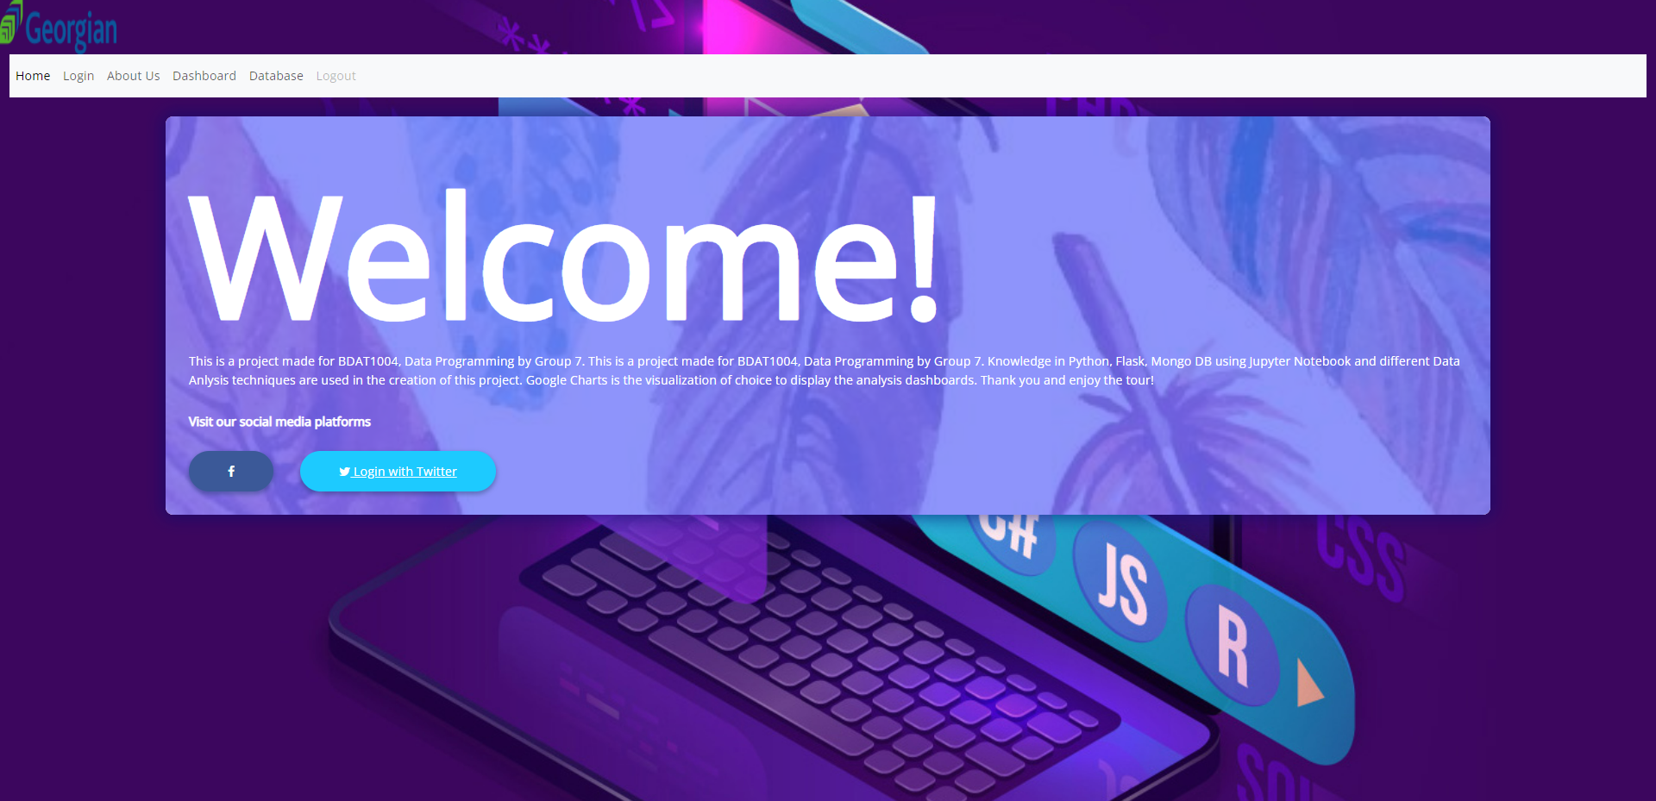
Home Page

Slide 9
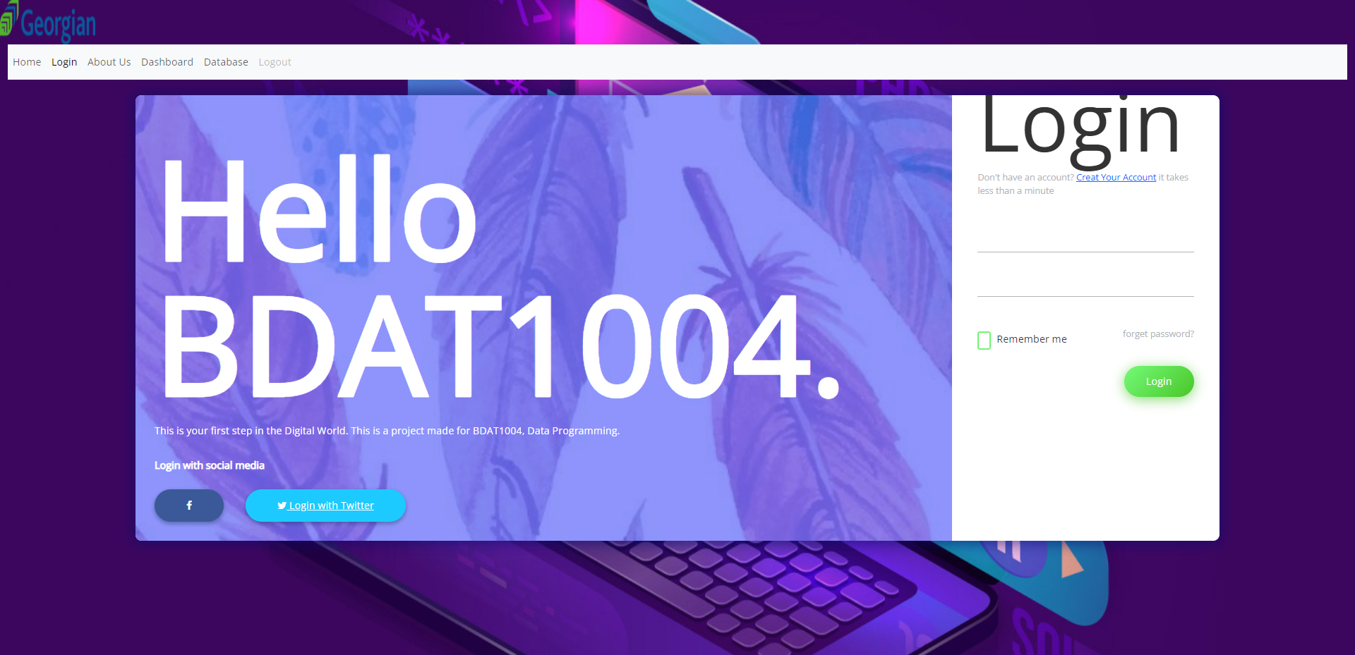
Log In Page

Slide 10
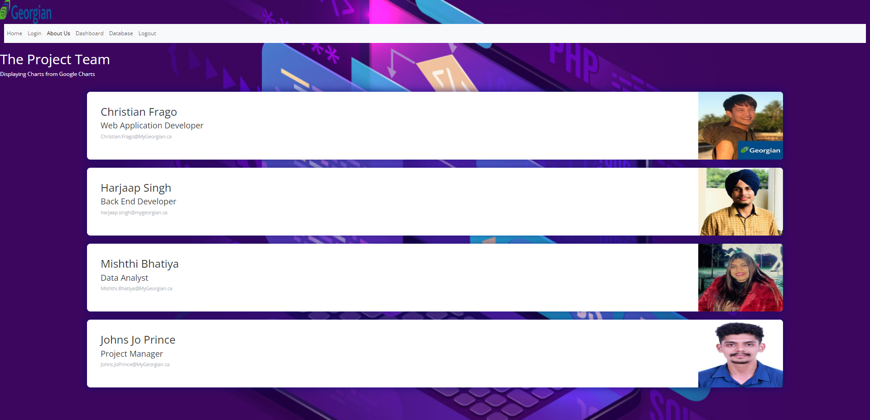
Team Members Page

Slide 11
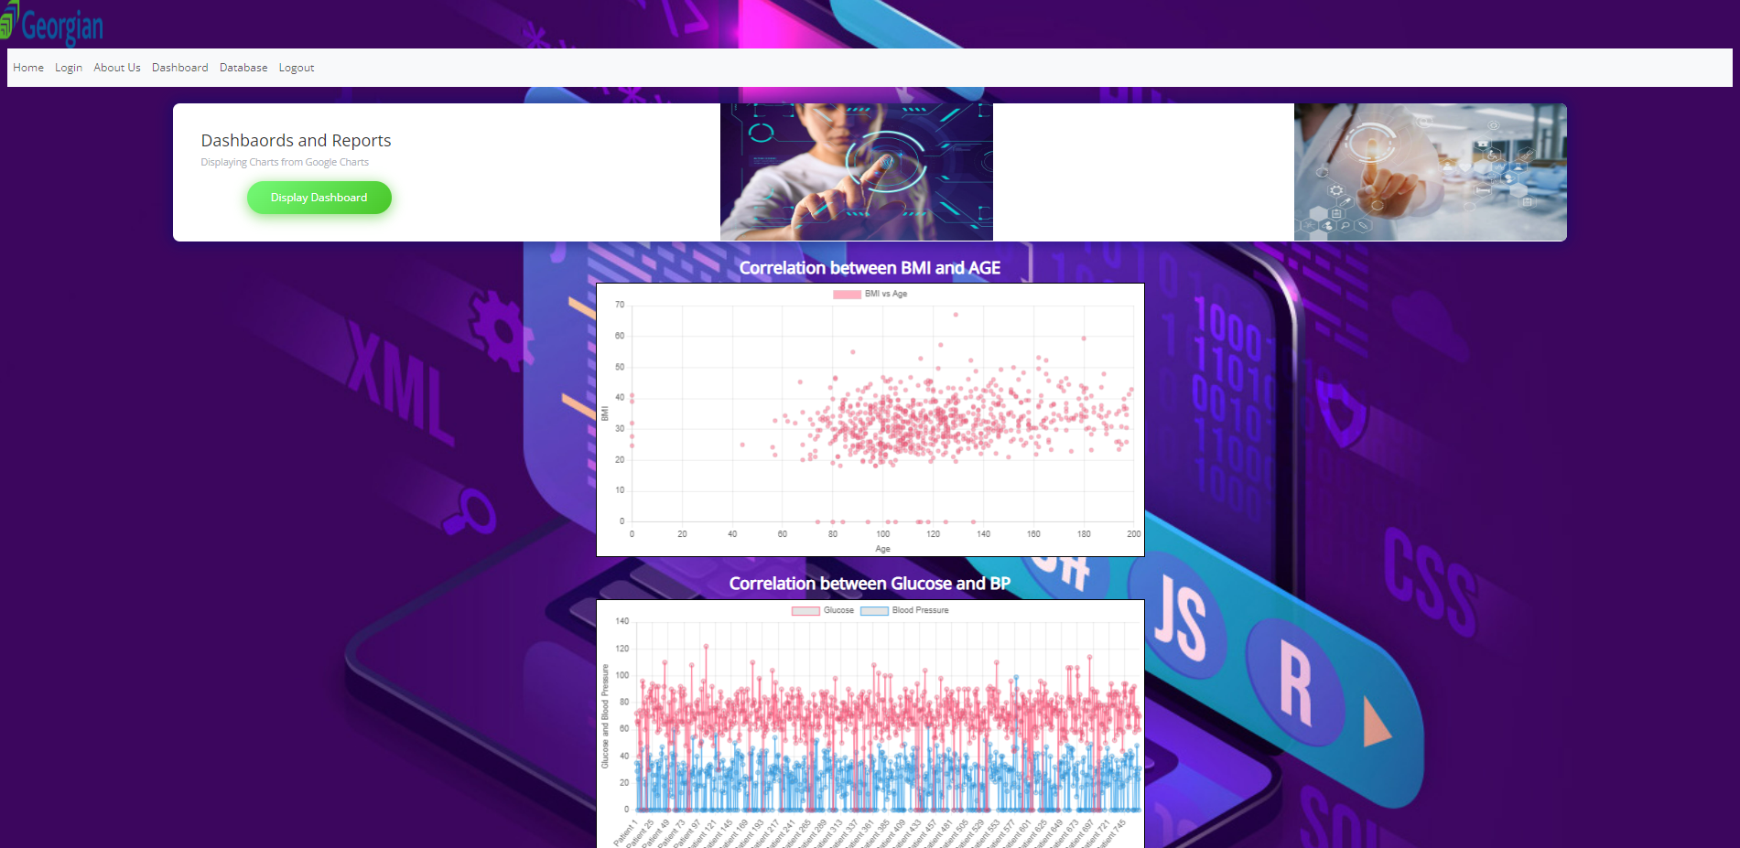
Dashboards Page

Slide 12
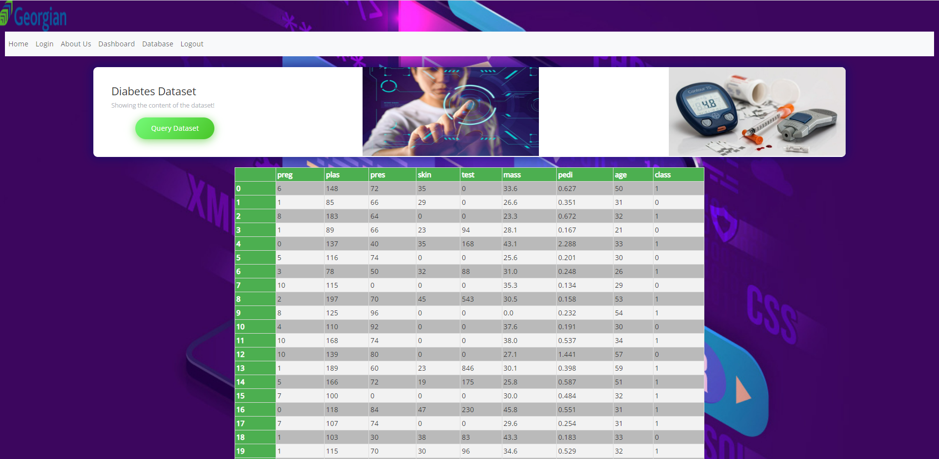
Database Page

Slide 13
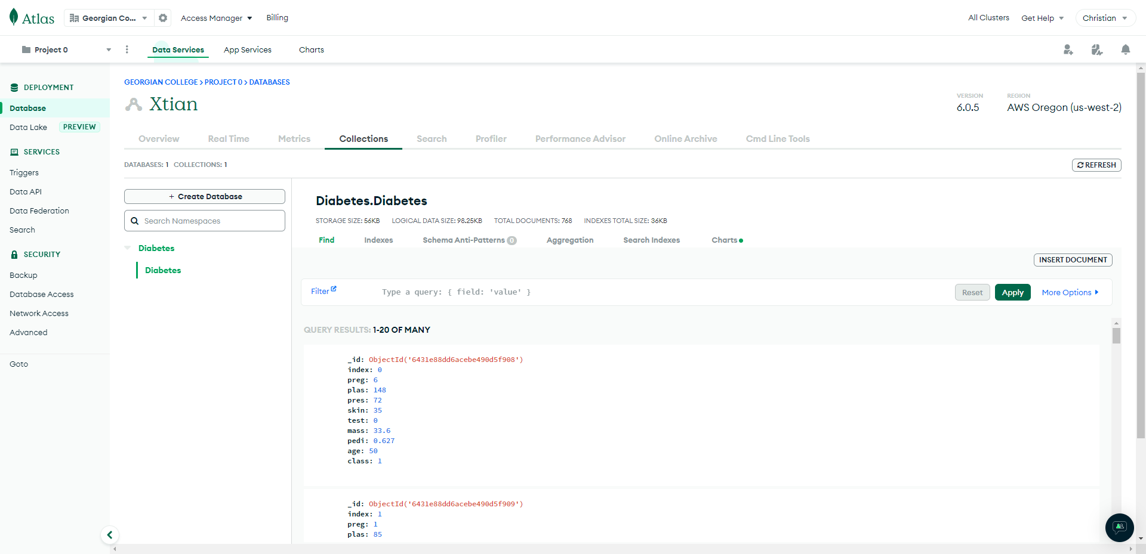
Mongo DB

Slide 14
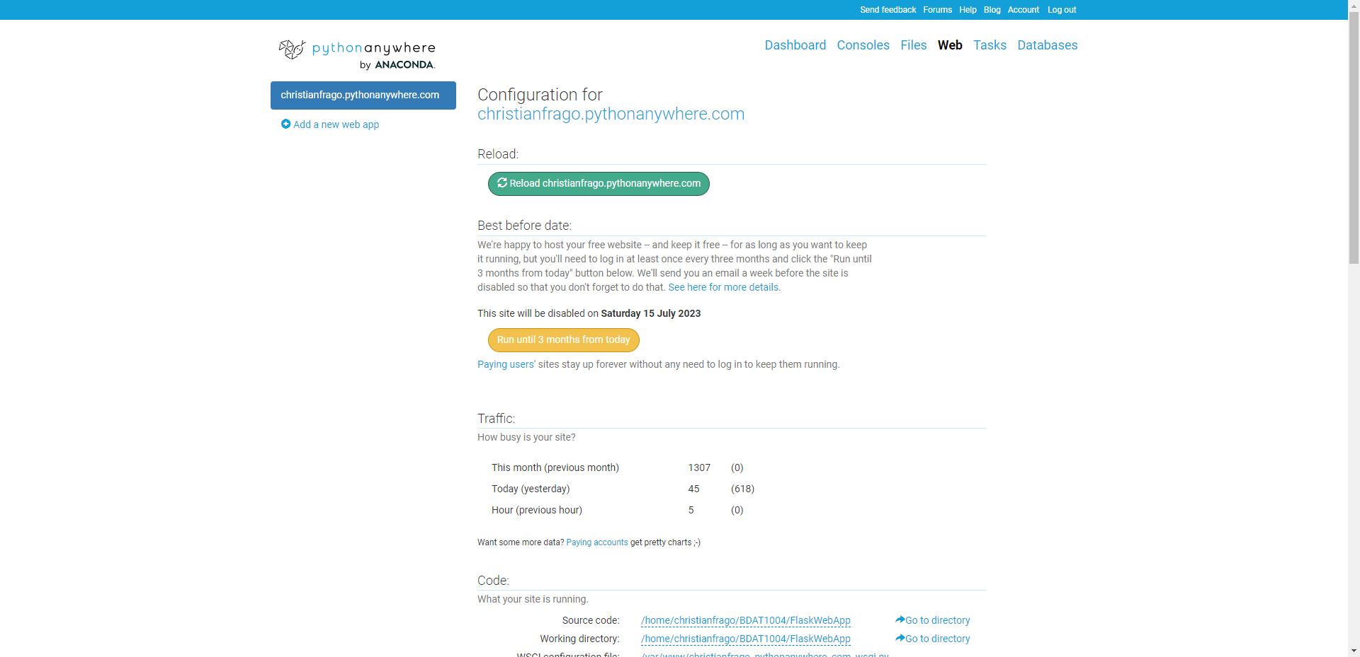
Python Anywhere

Slide 15


